Slide 1
US Housing Market Analysis & Insights: 2008 – 2019
By: Adam Iona, Chris Marchini, Remco Mooij, and Tolu Omotunde
1/21/2020

Slide 2
Agenda
Project Overview
Key Questions & Data Sources/Data Used
Data Cleanup & Exploration
Data Analysis Process + Answered Questions
Discussion of Results
Postmortem & Future Research
Questions

Slide 3
Project Overview
Goal
Analyze the housing market between 2008 and 2019.
What we analyzed
Top states with highest median sales price increases and decreases
Results
Median prices sales prices for homes steadily increased nationwide starting around 2011-2012
Median sales prices and foreclosure resales
Relationship between consumer/market variables and median sales prices
Future median sales prices based on relationships between consumer/market variables and median sales prices
Housing prices increased the most in DC, CA, CO, WA, and MA
Housing prices decreased the most in CT, NJ, MD, NM, and WV
Median sales prices correlated differently with our variables by state
Determine where and why the housing market has rebounded since its collapse around 2008
Wanted to make an analysis to help potential homeowners better understand the housing market (e.g. how are prices trending, where it’s cheaper/more expensive, etc.)
Future prices depend on user input and vary by state

Slide 4
Key Questions
How have the average median house sales and foreclosure resale rates trended since 2008?
What are the top five states with the highest increases and highest decrease in median house prices since 2008?
What consumer/market variables affected median sales prices for homes since 2008?
Based on the results of Question 3, what may future median sales prices look like?

Slide 5
Data Sources and Data Used
Key Questions | Primary Data Sources | Data Used
 |  | Zillow Home Value Index | Med. Sale Price | Monthly Home Sales | Foreclo. Resales | Divorce Rates | Unemploy. Rates | Student Loan Debt | Total Debt | Median Household Income
1 | Zillow | x | x |  | x
2 | Zillow |  | x
3 | Zillow, CDC/NCHS, Bureau of Labor Statistics, New York Federal Consumer Credit Panel/Equifax, Census Bureau | x | x | x | x | x | x | x | x | x
4 | Zillow, CDC/NCHS, Bureau of Labor Statistics, New York Federal Consumer Credit Panel/Equifax, Census Bureau | x | x | x | x | x | x | x | x | x

Slide 6
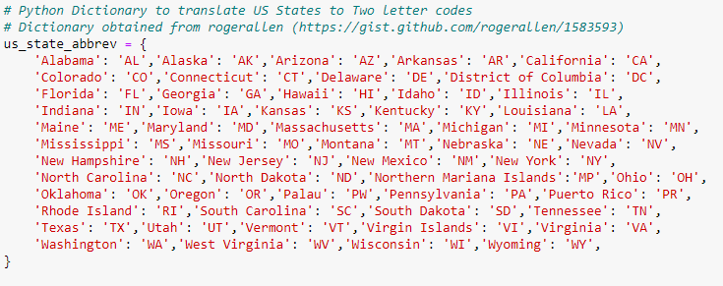
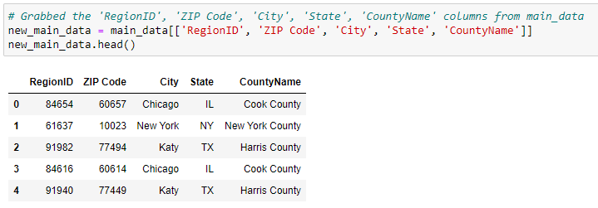
Data Cleanup & Exploration
Cleanup was straightforward but lengthy
Several data sources merged on state names/abbreviations
Checked dataframes to ensure data was correct
Ran into having too much data and APIs not working
Shelved excess data to prevent scope creep and dropped APIs.

Slide 7
Data Analysis Process
Identify
Identified which types of data we would need
Merge
Merged our data on a common variable, which for us was the state abbreviations
Isolate + Analyze
Isolated the data from our new merged data for analysis. Analyses included but weren’t limited to national/state averages, percent changes over the period analyzed, and multiple regressions.

Slide 8
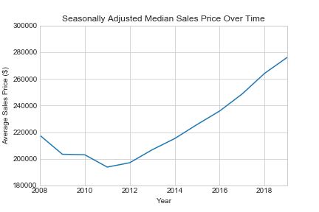
How have the average median house sales and foreclosure resale rates trended since 2008?
Average Median House Sales
Foreclosure Resales %
The national average median sales prices began increasing in 2011 and have continued to increase since then, indicating the market started to rebound in 2011
Notes:
Data source: Zilllow
Data used: Zillow Home Index Value

Slide 9
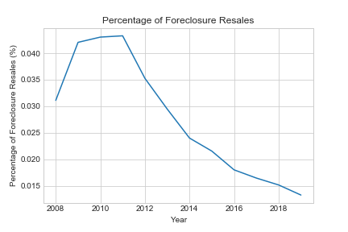
How have the average median house sales and foreclosure resale rates trended since 2008?
Average Median House Sales
Foreclosure Resales %
The foreclosure resales percentages have steadily declined since 2011 and continue to trend downward, which further indicates 2011 was a pivotal year for the market’s rebounding.
Notes:
Data source: Zilllow
Data used: Zillow Home Index Value

Slide 10
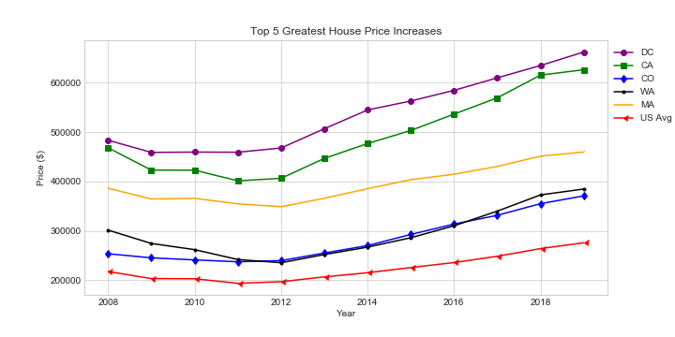
What are the top 5 states with the highest increases and highest decrease in median house prices since 2008?
Top 5 States with Highest Increases
Top 5 States with Highest Decreases
DC, California, Colorado, Washington, and Massachusetts show median sales price increases starting around 2011-2012, which follows a consistent pattern with the national median sales price average.
Notes:
Data source: Zilllow
Data used: Zillow Home Index Value

Slide 11
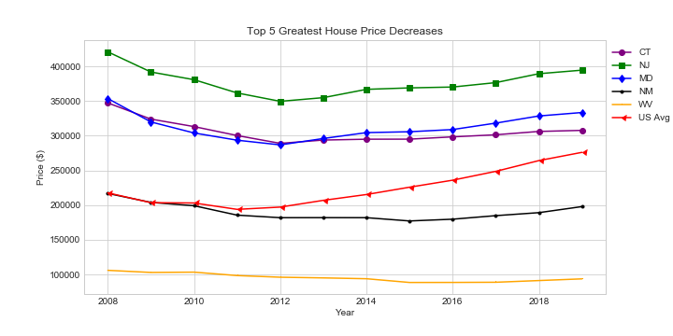
What consumer/market variables affected median housing prices since 2008?
Top 5 States with Highest Increases
Top 5 States with Highest Decreases
New Jersey, Maryland, and Connecticut appear to have begun rebounding around 2012, whereas New Mexico and West Virginia started slowly rebounding around 2015.
Notes:
Data source: Zilllow
Data used: Zillow Home Index Value

Slide 12
What consumer/market variables affected median housing prices since 2008?
We developed a correlation matrix to see how strongly correlated the following eight variables are to median sales prices:
Zillow Home Index Value
Monthly Home Sales
Foreclosure Resales
Divorce Rates
Unemployment Rates
Student Loan Debt
Total Debt
Household Median Income
The strength of these variables’ correlations with median sales prices fluctuated from state to state.
We’re showing the top correlated variables for DC and Connecticut to be illustrative.
Notes:
Data source: Zilllow
Data used: Zillow Home Index Value

Slide 13
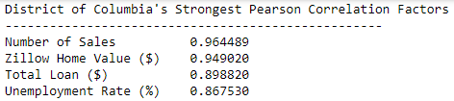
What consumer/market variables affected median housing prices since 2008?
Example w/ Highest Price Increase (DC)
Example w/ Highest Price Decrease (CT)

Slide 14
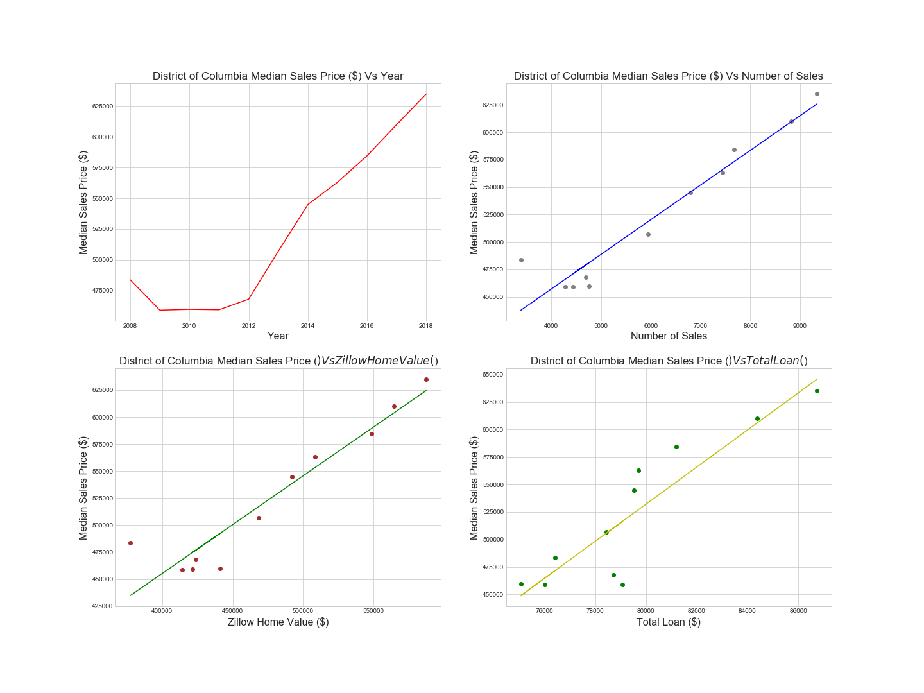
What consumer/market variables affected median housing prices since 2008?
Example w/ Highest Price Increase (DC)
Example w/ Highest Price Decrease (CT)
Notes:
Data source: Zilllow
Data used: Zillow Home Index Value

Slide 15
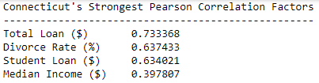
What consumer/market variables affected median housing prices since 2008?
Example w/ Highest Price Increase (DC)
Example w/ Highest Price Decrease (CT)

Slide 16
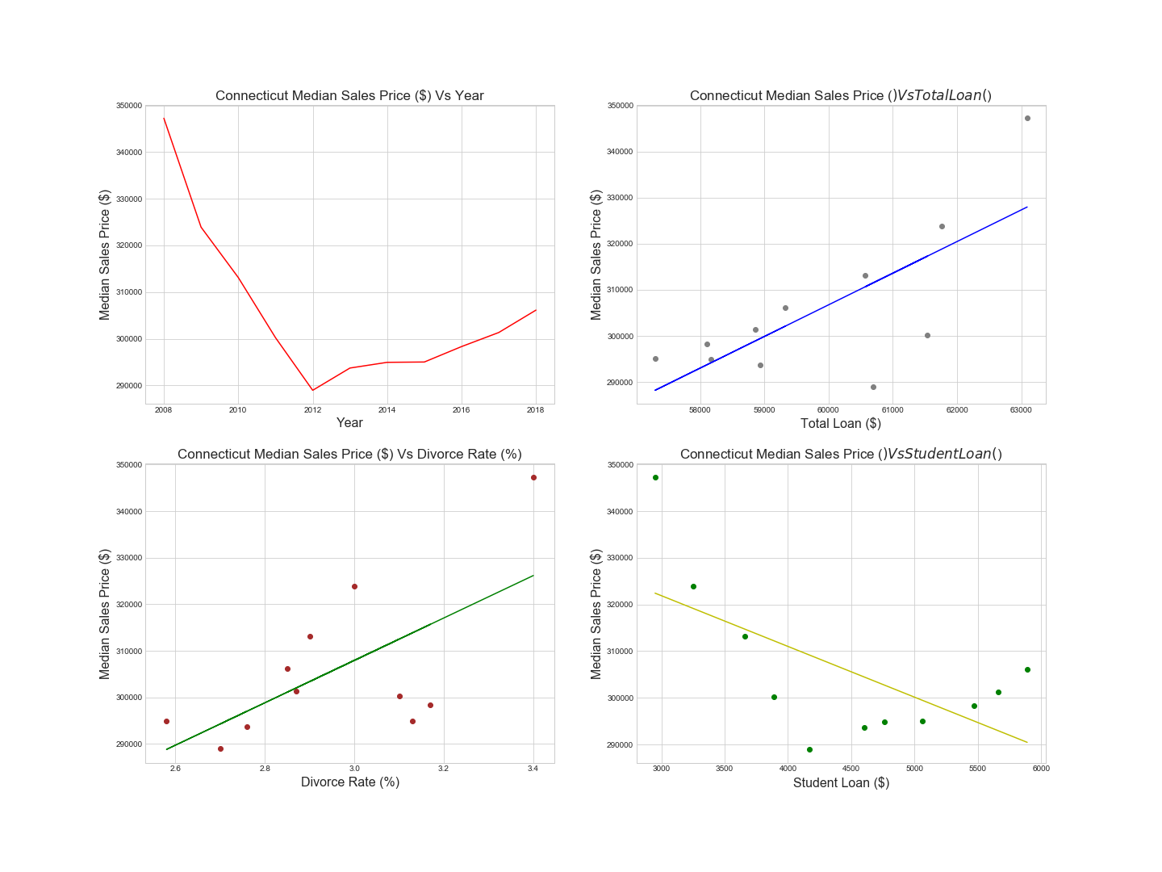
What consumer/market variables affected median housing prices since 2008?
Example w/ Highest Price Increase (DC)
Example w/ Highest Price Decrease (CT)

Slide 17
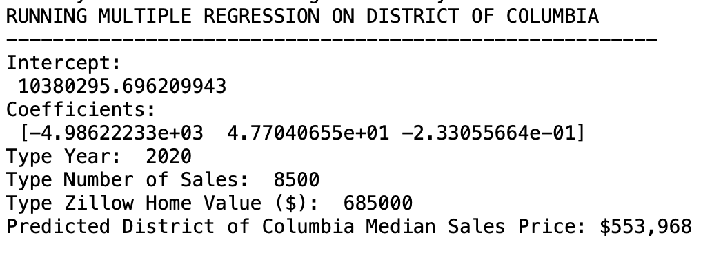
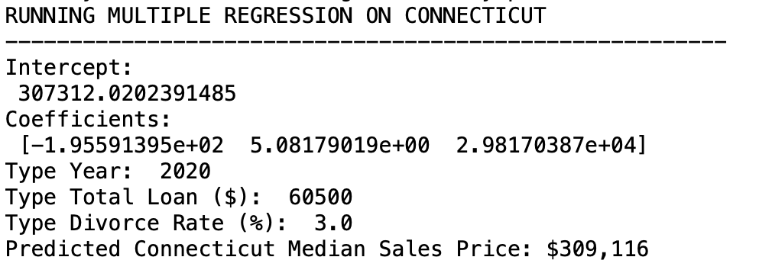
Based on the results of Question 3, what may future median sales prices look like?
This varies by state, the variables related, and the scenarios you run.
The following are what DC and Connecticut may look like in 2020 based on the following assumptions:

Slide 18
Discussion of Results
We gained insights into the market rebounding:
Median sales prices increased/foreclosures decreased since ‘11-’12
Most states started to rebound around 2011-2012
Variables correlated to median sales prices vary from state to state
The market outlook per state varies depending on the input
Things that remain unclear based on our results:
Was there a specific event in 2011 that caused the housing market to mostly rebound?
Why didn’t NM and WV housing prices rebound around 2011-2012?
Why did certain variables affect some states more than others?

Slide 19
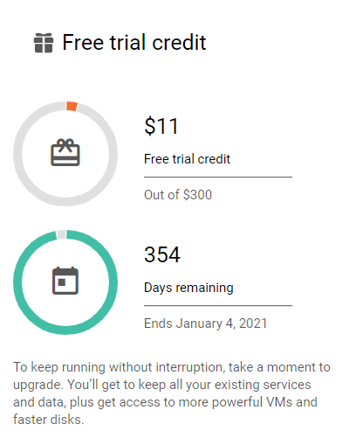
Postmortem + Future Research
Key issues we encountered:
Unable to use some data, specifically APIs
Preventing scope creep with additional variables
Merging our disparate data into one Jupyter Notebook
Future research recommendations:
What other variables might determine why the housing market rebounded?
Why did states like NM and WV not rebound in 2011-2012?
What would this model look like applied at more of the local level?
How did the rental market change in comparison to the housing market?

Slide 20
Thank you! Questions?

Slide 21
Appendix

Slide 22
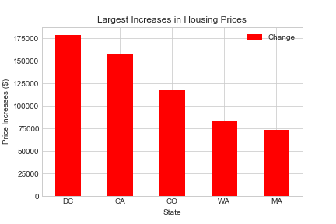
What are the top 5 states with the highest increases and highest decrease in median house prices since 2008?
Top 5 States with Highest Increases
Top 5 States with Highest Decreases
Since 2008, DC, California, Colorado, Washington, and Massachusetts saw the highest increases in house prices
Notes:
Data source: Zilllow
Data used: Zillow Home Index Value

Slide 23
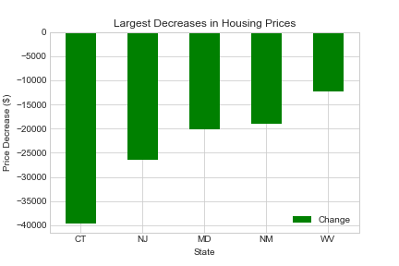
What are the top 5 states with the highest increases and highest decrease in median house prices since 2008?
Top 5 States with Highest Increases
Top 5 States with Highest Decreases
Connecticut, New Jersey, Maryland, New Mexico, and West Virginia saw the highest decreases in house prices
Notes:
Data source: Zilllow
Data used: Zillow Home Index Value

Slide 24
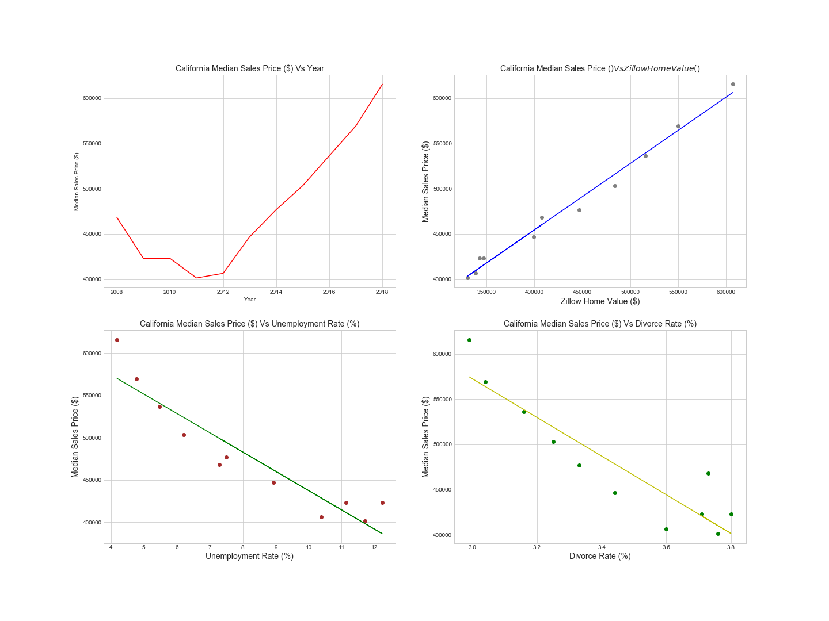
For states with the highest median sales price increase, what consumer/market variables affected median housing prices since 2008?
California
Colorado
Washington
Massachusetts
Notes:
Data source: Zilllow
Data used: Zillow Home Index Value

Slide 25
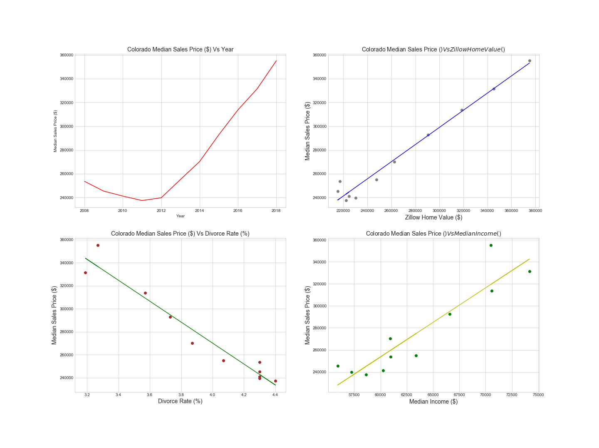
For states with the highest median sales price increase, what consumer/market variables affected median housing prices since 2008?
California
Colorado
Washington
Massachusetts
Notes:
Data source: Zilllow
Data used: Zillow Home Index Value

Slide 26
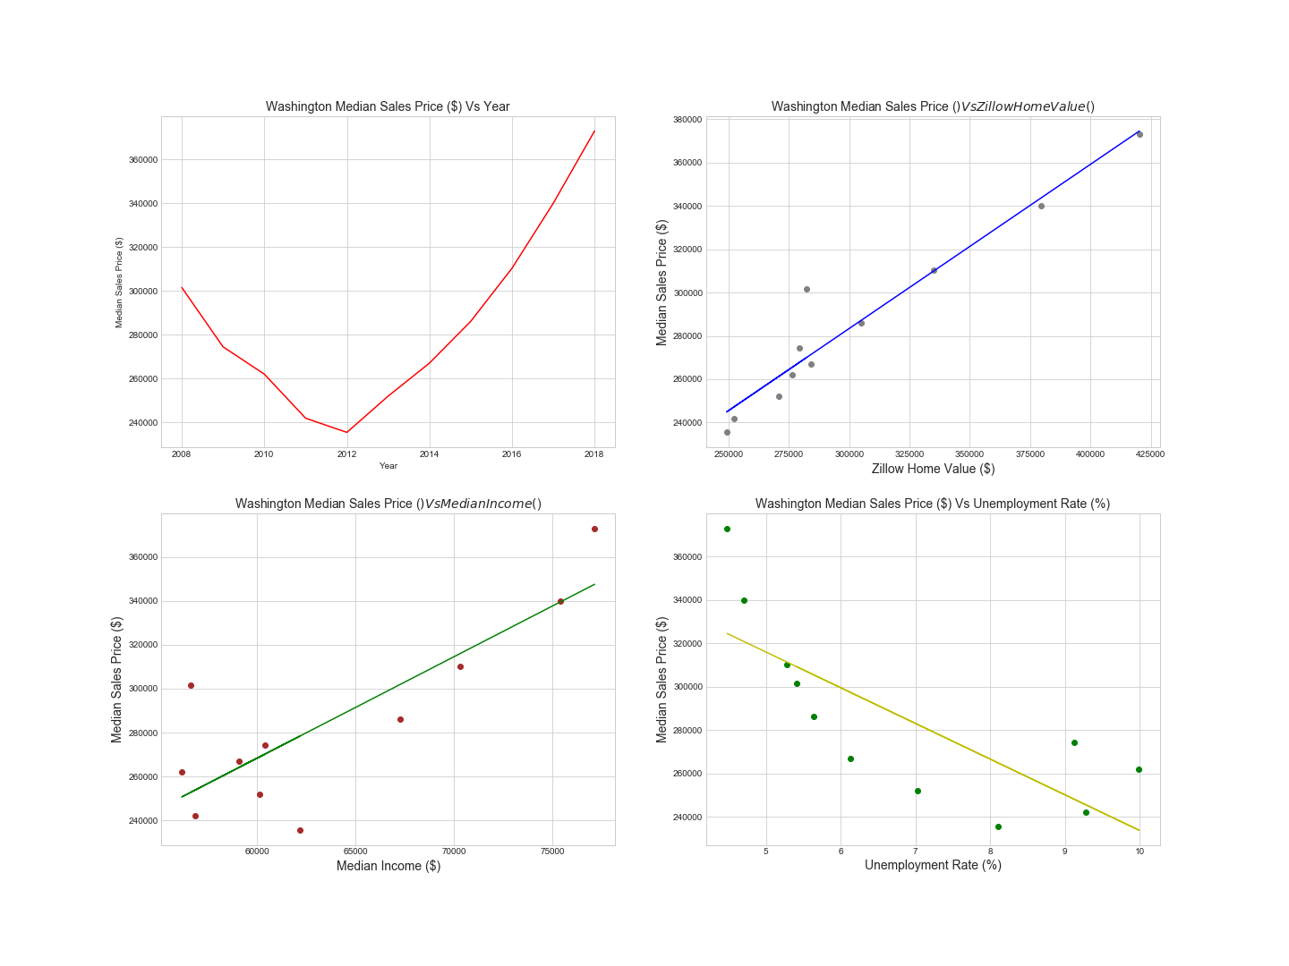
For states with the highest median sales price increase, what consumer/market variables affected median housing prices since 2008?
California
Colorado
Washington
Massachusetts
Notes:
Data source: Zilllow
Data used: Zillow Home Index Value

Slide 27
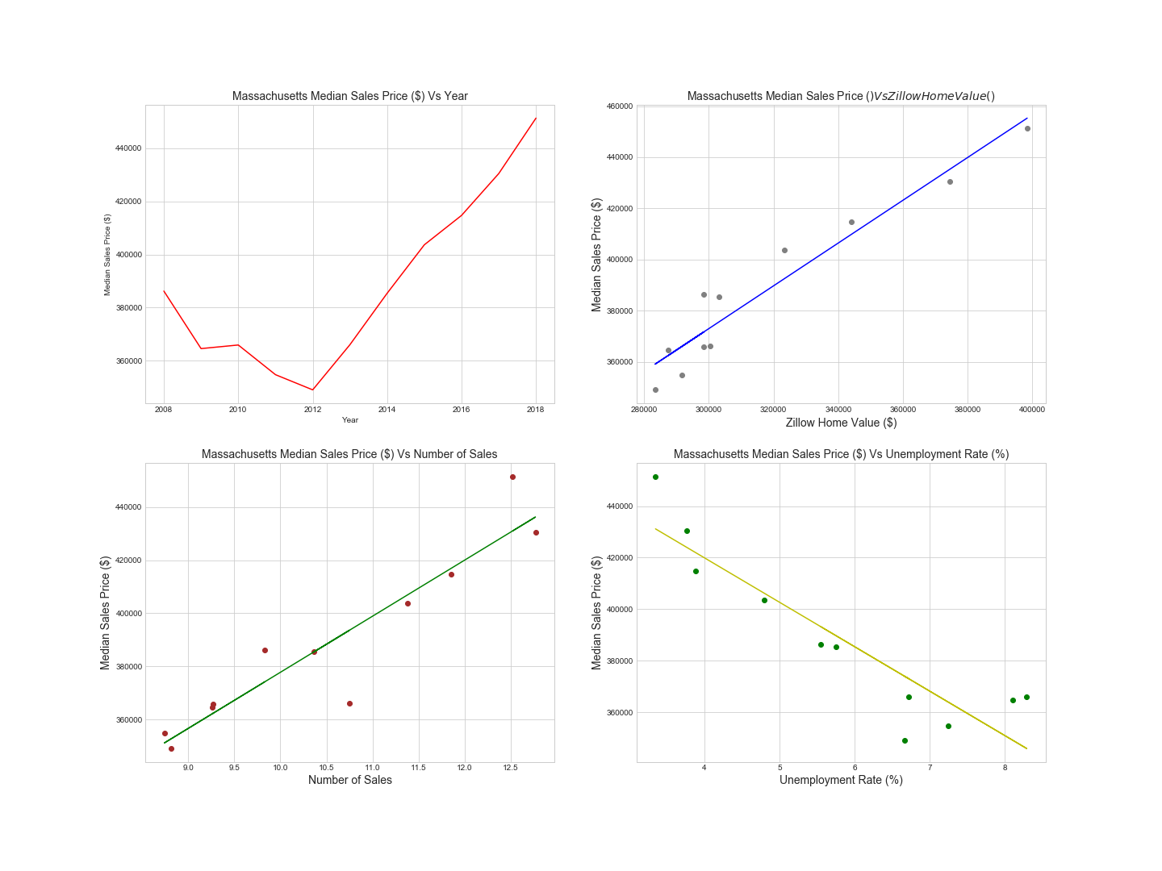
For states with the highest median sales price increase, what consumer/market variables affected median housing prices since 2008?
California
Colorado
Washington
Massachusetts
Notes:
Data source: Zilllow
Data used: Zillow Home Index Value

Slide 28
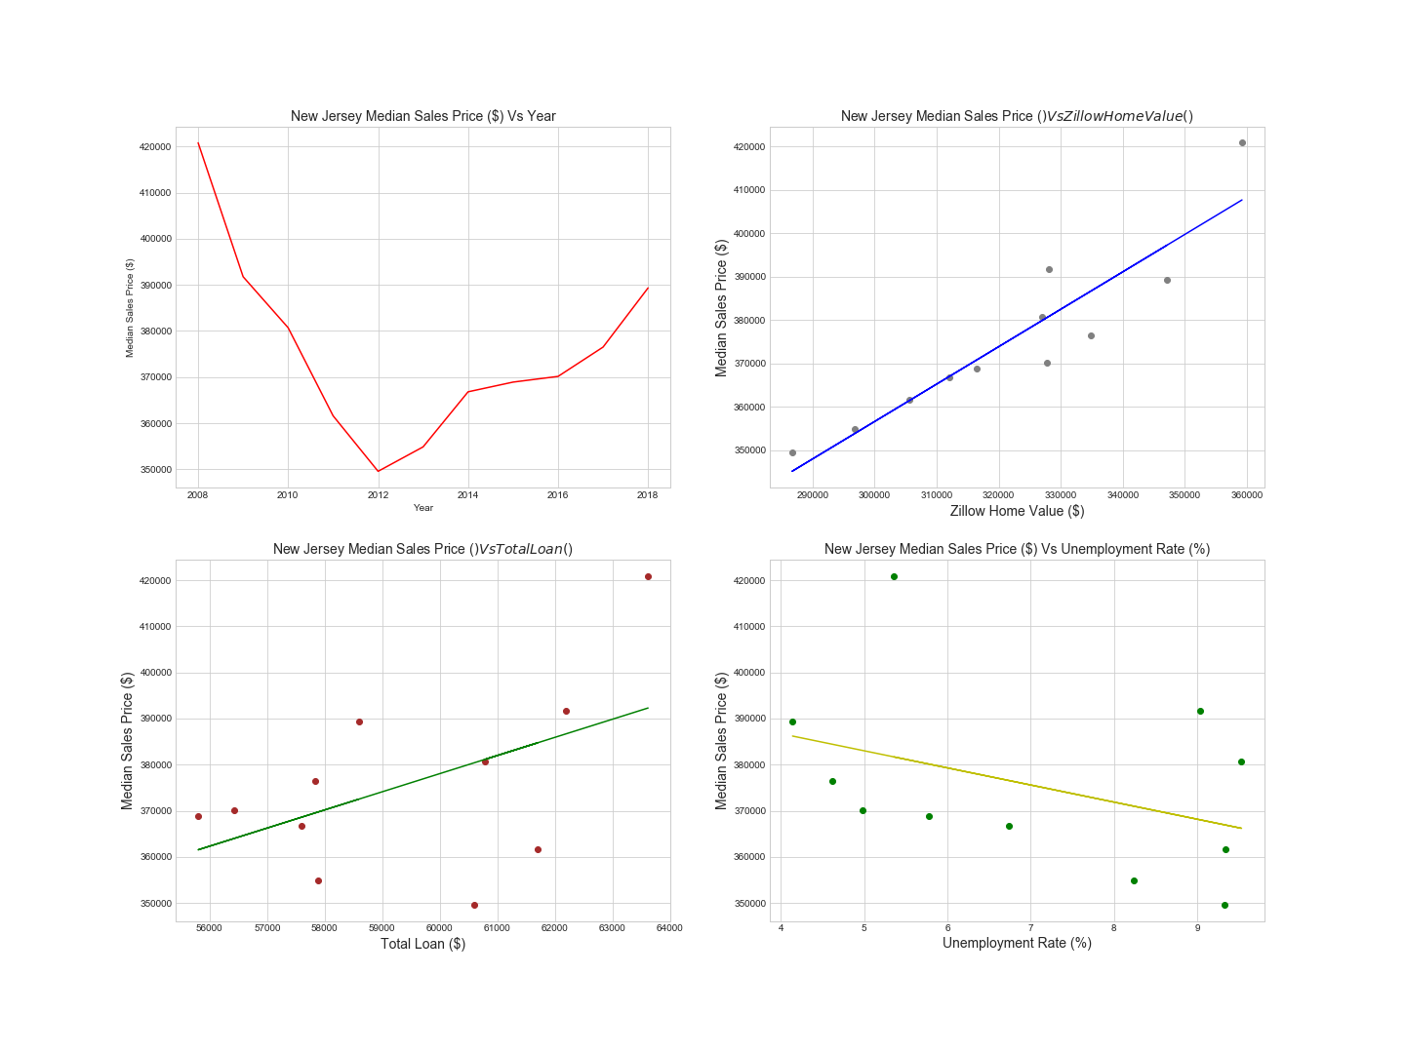
For states with the highest median sales price decreases, what consumer/market variables affected median housing prices since 2008?
New Jersey
Maryland
New Mexico
West Virginia
Notes:
Data source: Zilllow
Data used: Zillow Home Index Value

Slide 29
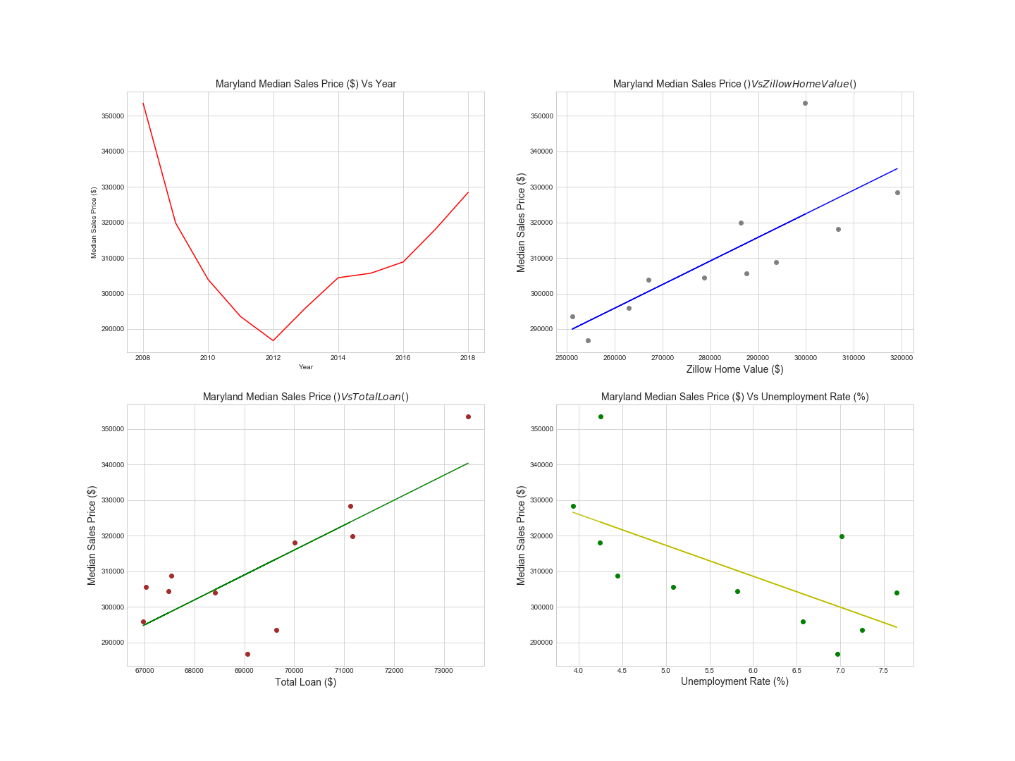
For states with the highest median sales price decreases, what consumer/market variables affected median housing prices since 2008?
New Jersey
Maryland
New Mexico
West Virginia
Notes:
Data source: Zilllow
Data used: Zillow Home Index Value

Slide 30
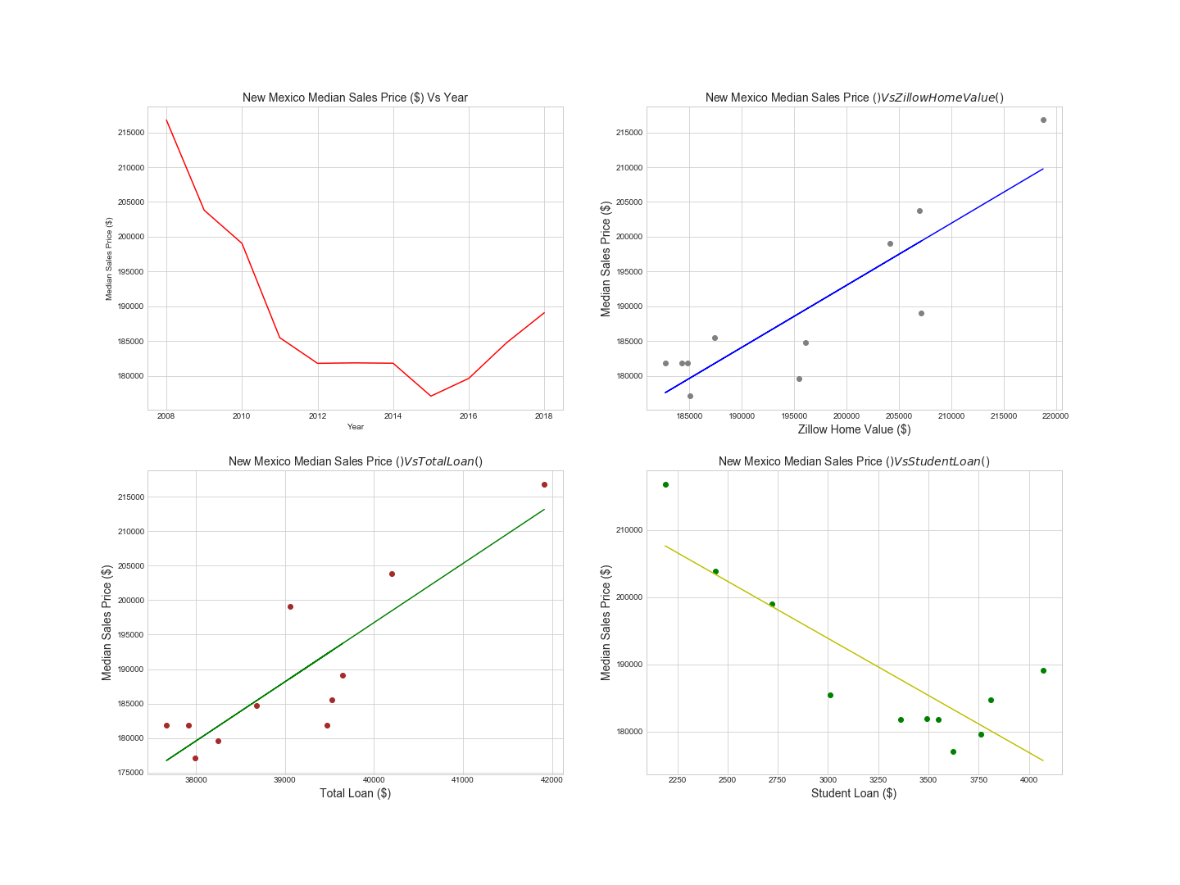
For states with the highest median sales price decreases, what consumer/market variables affected median housing prices since 2008?
New Jersey
Maryland
New Mexico
West Virginia
Notes:
Data source: Zilllow
Data used: Zillow Home Index Value

Slide 31
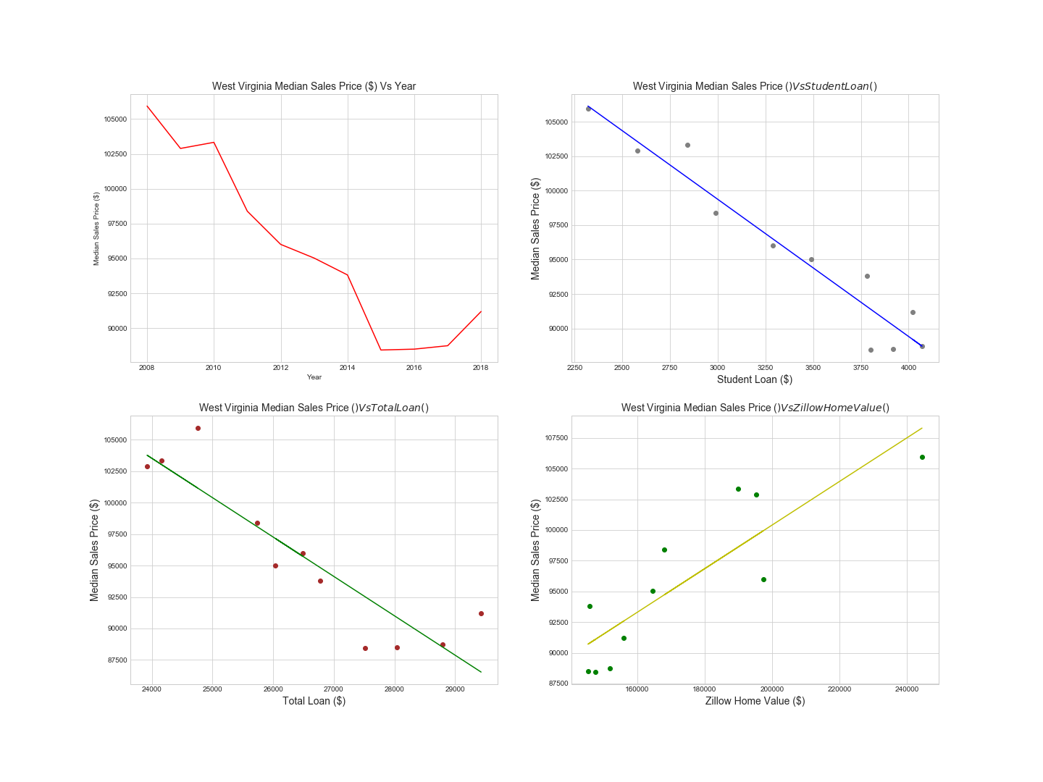
For states with the highest median sales price decreases, what consumer/market variables affected median housing prices since 2008?
New Jersey
Maryland
New Mexico
West Virginia
Notes:
Data source: Zilllow
Data used: Zillow Home Index Value

